Slide 1


Text Processing For NLP Lemmatization In Text Processing
Learn how lemmatization enhances text analysis and supports information retrieval. Discover the differences between lemmatization and stemming and how to leverage them for improved machine learning.

Slide 2
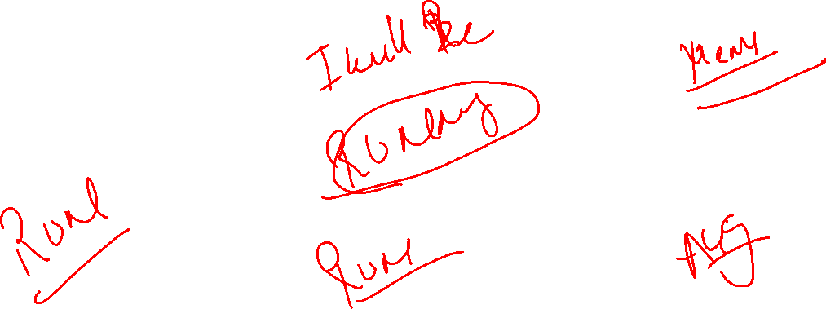
Understanding Lemmatization: What is it?
Linguistic Analysis
Precision
Multi-lemma
Lemmatization is a linguistic analysis that involves mapping words to their base or root form.
Unlike stemming, lemmatization considers context and the part of speech, producing more accurate and precise results.
Words can have multiple lemma forms, and the choice of which one to use can depend on context.

Slide 3

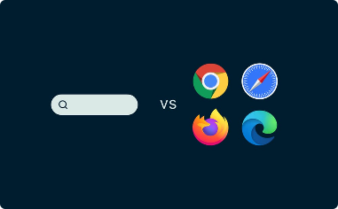

The Importance of Lemmatization in NLP
Document Analysis
Search Engine
Language Translation
Lemmatization is critical for accurate document analysis and natural language understanding.
Lemmatization enhances search engine performance and improves the user experience.
Used for improving language translation by converting words to their base form before translation.

Slide 4
Lemmatization vs. Stemming: Key Differences
Accuracy
Lemmatization produces more accurate results by preserving the meaning of the text.
1
2
3
Functionality
Speed
Lemmatization maps words to their base form, while stemming removes prefixes and suffixes to produce a root word.
Stemming is quicker than lemmatization but does not account for part of speech variations.

Slide 5

How Lemmatization Enhances Text Analysis
1
Removing Ambiguity
2
Improving Accuracy
Lemmatization helps remove ambiguity by providing a common base form for words.
Produce accurate results by taking into account the context and part of speech.
3
Finding Key Terms
Lemmatization helps find key terms that are not apparent in the original text.

Slide 6
Techniques for Effective Lemmatization
Part of Speech Tagging
WordNet
Contextual Analysis
A lexical database that links words together based on their meanings and relationships to aid in lemmatization.
Assigning a part of speech to each word in the text to help with the lemmatization process.
Using context to determine the correct lemma form of a word based on its surrounding words.

Slide 7



Lemmatization in Action: Real-world Applications
Medical Research
Customer Service
News Analysis
Lemmatization is used to identify medical terms in scientific literature for research and analysis.
Lemmatization is used in chatbots to understand customer concerns and provide accurate responses.
Lemmatization is used to extract key information and topics from news articles for analysis.

Slide 8
Lemmatization's Role in Information Retrieval
Query Expansion
Relevance Ranking
Topic Modeling
Lemmatization expands queries to include alternative forms of words for more comprehensive results.
Used to group and categorize documents based on their underlying topics and themes.
Lemmatization helps produce more relevant rankings by considering the context and part of speech.

Slide 9
Enhancing Semantic Analysis with Lemmatization
Topic Modeling
Lemmatization is used to group and categorize documents based on their underlying topics and themes.
1
2
3
Named Entity Recognition
Sentiment Analysis
Lemmatization is used to recognize named entities for deeper analysis of their properties and relationships.
Lemmatization is used to extract the base meaning of words for more accurate sentiment analysis.

Slide 10

Challenges and Considerations in Lemmatization
1
Homonyms
2
Linguistic Variation
Words with multiple meanings can produce incorrect lemmas if not analyzed in context.
Different languages have different rules for lemmatization, making it challenging to apply to multilingual analysis.
3
Performance
Lemmatization can be slow and resource-intensive, particularly when analyzing large volumes of text.

Slide 11

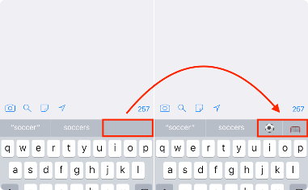

Leveraging Lemmatization for Improved Machine Learning
Automation
Predictive Text
Image Captioning
Lemmatization is used to automate the creation of training datasets for machine learning models.
Lemmatization enhances the accuracy of predictive text models by reducing linguistic complexity.
Lemmatization is used to generate textual captions for images, improving retrieval and searchability.

Slide 12

Conclusion
Lemmatization is a key technique for enhancing text analysis and information retrieval. Its accuracy and precision make it invaluable in many contexts, from chatbots to machine learning models. While there are challenges and considerations to using it, the benefits make it worth the investment of time, effort, and resources.

